Slide 1

2
0
2
1
Software Project and Process Management
Course Project Presentation
——Online Snack Store
Team Member
1853543 黄弋鸥
1852345 毛靖鑫
1853898 谭忠煜
1851350 陈扬森
Notes:
大侠素材铺 淘宝店：https://dxpu.taobao.com/

Slide 2
CONTENT
Monitor and Control
Business Case
05
03
Risk Management
01
04
02
06
Project Charter
Stakeholders
WBS
Activity Network
Resource Allocation
Project Implement
Prototype

Slide 3
1
Part 01
Business Cases

Slide 4
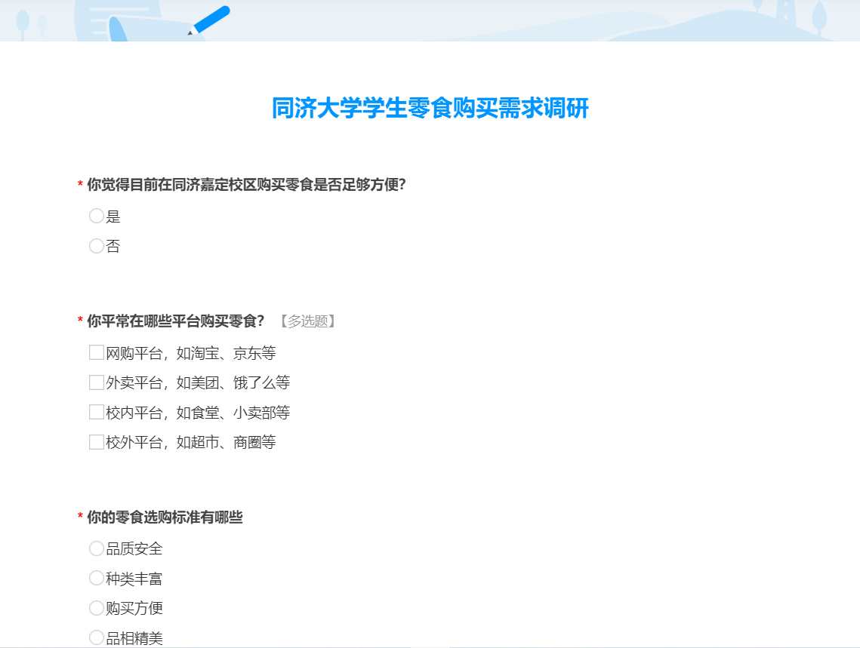
1
Background
Notes:
如今，淘宝京东网上购买零食很方便但运输周期较长,外卖存在运费、安全与卫生问题，我们的项目为嘉定的同学们带来更便捷安全的网络零食购买平台。

Slide 5

1
Background
Notes:
如今，淘宝京东网上购买零食很方便但运输周期较长,外卖存在运费、安全与卫生问题，我们的项目为嘉定的同学们带来更便捷安全的网络零食购买平台。

Slide 6
1
Background
Nowadays, online shopping is very developed, but it will still take two to three days for transportation. We hope to build a snack trading platform between the small snack shops nearby the campus and the students, where students can buy snacks easily in less than one day
Notes:
如今，淘宝京东网上购买零食很方便但运输周期较长,外卖存在运费、安全与卫生问题，我们的项目为嘉定的同学们带来更便捷安全的网络零食购买平台。

Slide 7
1
Requirement
Access of the game store for merchants and management of the company must be accomplished through a Web site.
The system must allow the customer to search our system for his or her favorite snack and add the snack to the shopping cart or wish list.
After the purchase of certain snacks, and after the purchase of snacks to convey their personal opinions on the product, such as the freshness of the product, how the product looks, etc.
The system must provide a platform for sellers to add new products and manage information about their products and easily manage orders.
…
Notes:
需求告诉我们要为同学们提供一个便捷、权威、舒适的网络平台,提供安全、新鲜、品相好的产品

Slide 8
1
Business Case -- Executive Summary
Problem:
In the early stages of platform development, how to ensure enough novel snack content for players to choose.
Security: how to make sure that the content of the snack is not pirate.
At the same time how can we commit to the increment of platform reputation.
Opportunity:
If we can ensure full communication with manufacturers and users, and timely adjust the problems in the early stage of the platform, the business mode will be more standardized and safe.
With a unique sales style, in the follow-up development, we will strive to create a platform atmosphere, guide the platform culture, and give users a greater sense of belonging and convenience, so as to lay a solid foundation for future development.
Notes:
存在着问题与机遇，我们要合理解决商品渠道问题、安全问题、知名度问题，我们的机遇是垂直领域下丰富的商业机会和作为校友所具有的亲和力。

Slide 9
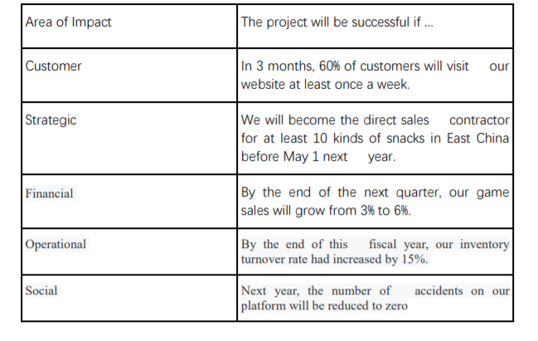
1
MOV（Measurable Organizational Values）
Notes:
我们量化了我们项目的商业目标，制作了MOV表，根据客户、策略、经济、执行、社会层面分别订立了目标。来评判我们项目能否成功
我们的项目对我们组织在客户方面的影响 项目对组织在经营策略上的影响（经营策略主要体现在从事哪方面的业务，因为我们主要扮演了一个中间商的角色，所以我们的经营策略的重头在于和哪些商家进行合作、进行怎样的合作）

Slide 10
1
Analysis of Alternatives
Alternatives
Description of alternative 1
Do nothing. The business is doing well, and we can continue to operate without this new project.
Description of alternative 2
Adopting or adapting an application developed by a different area or department within the organization.
Description of alternative 3
Reengineering the existing system.
Description of alternative 4
Purchasing an off-the-shelf application package from a software vendor.
Description of alternative 5
Custom building a new application using internal resources or outsourcing the development to another company.
Description of alternative 6
Design and implement new intranet functions internally using most of the existing hardware and software may be the best choice
Notes:
我们一共有六种备选方案 啥也不做 采用现成的系统 全部重新设计 购买现成的软件 外围功能外包开发 基于组织内部现成系统进行二次开发

Slide 11
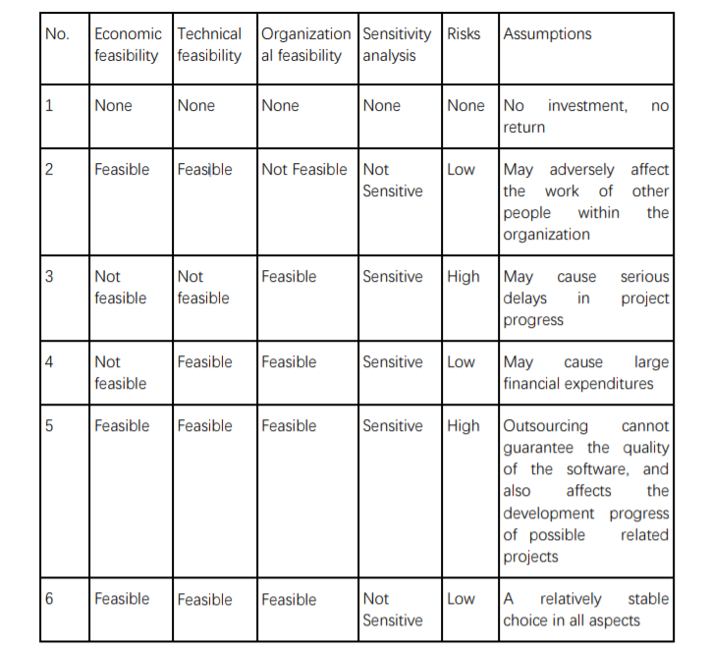
1
Analysis of Alternatives
Designing and implementing new intranet functions internally using most of the existing hardware and software may be the best choice
Notes:
最终我们的选择是——在组织内部现有的基础上进行部分新功能的开发。因为一方面，复用可以帮助我们控制成本，另一方面可以避免外包质量低下的问题、避免购买现成软件的学习和适配问题。

Slide 12
2
Part 02
Project Charter

Slide 13
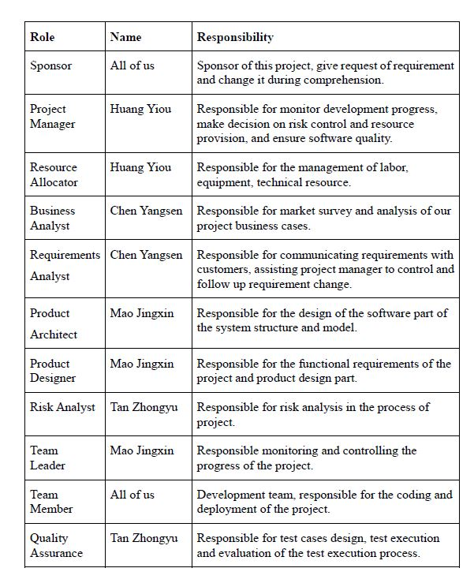
2
Stakeholders
Requirement provide and change
This part mainly shows the organization of our group members, their character in our project and the way of communication, that’s how to compose these people together.
We figure out our roles in the project.
Plan the activities and manage the team
Management related activities have their responsible persons
Manage the development team
The development team

Slide 14
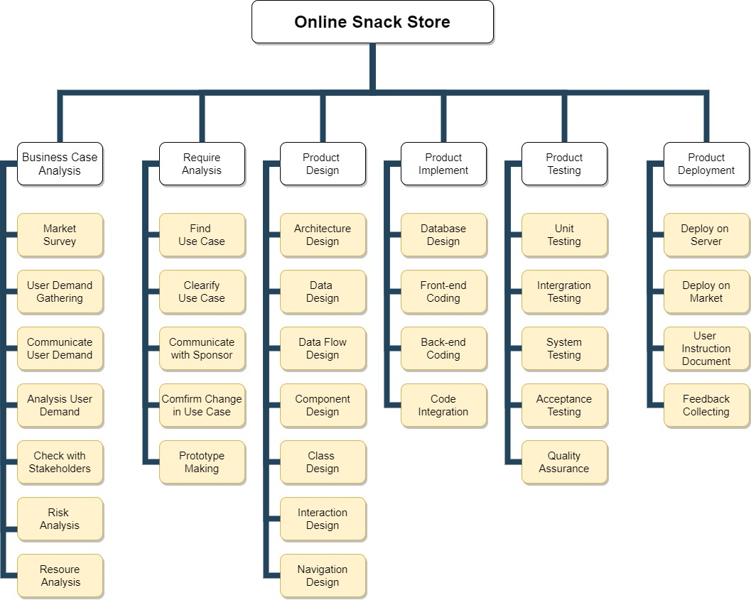
2
Work Breakdown Structure (WBS)
This part we will divide our project into several main parts and figure out the key activities in it.
The activities will be detailed in the next part.
We will figure out key activities and give a plan to conduct them.

Slide 15
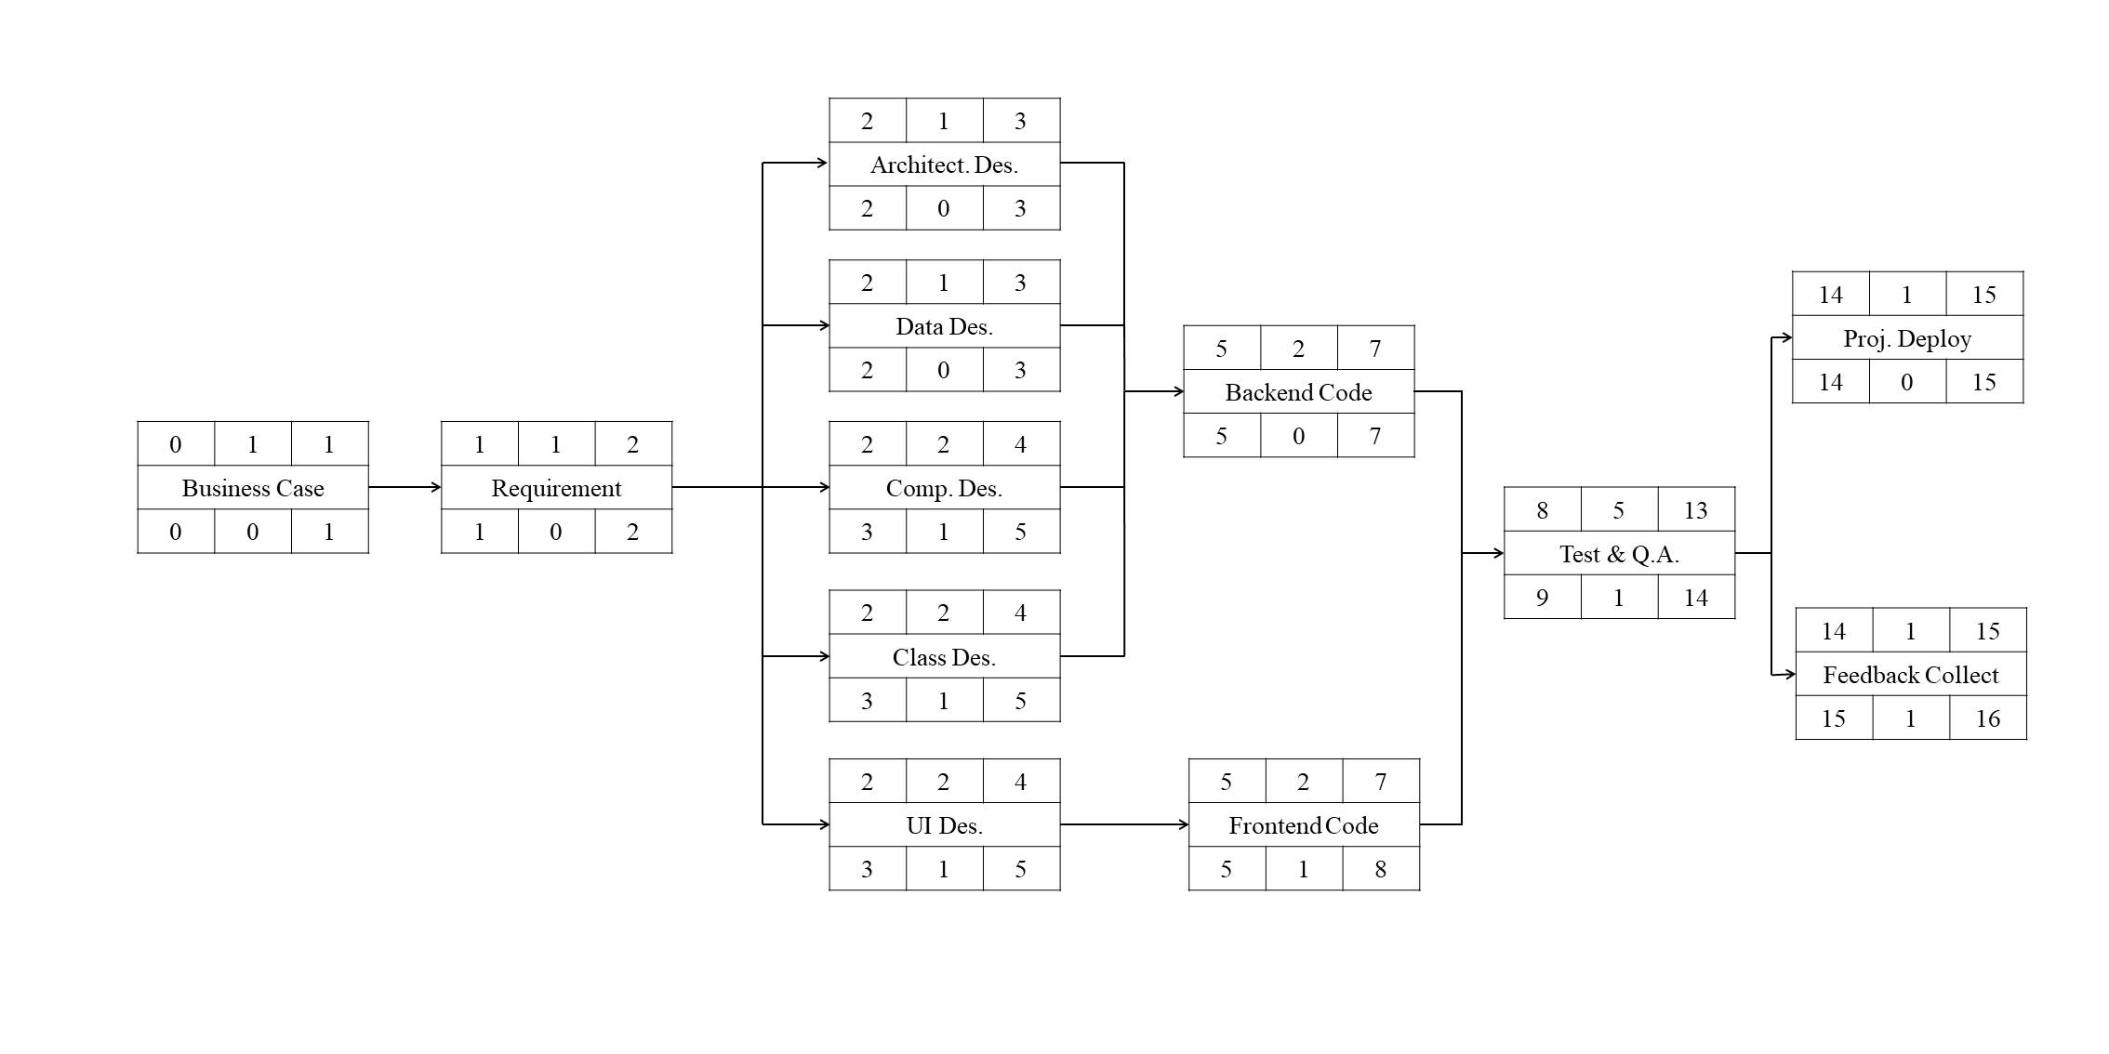
2
Critical Path Graph
Our project will start at March 5th, and end at June 30th according to plan. It will take about 16 weeks.
Critical path is marked by triangle sign.

Slide 16
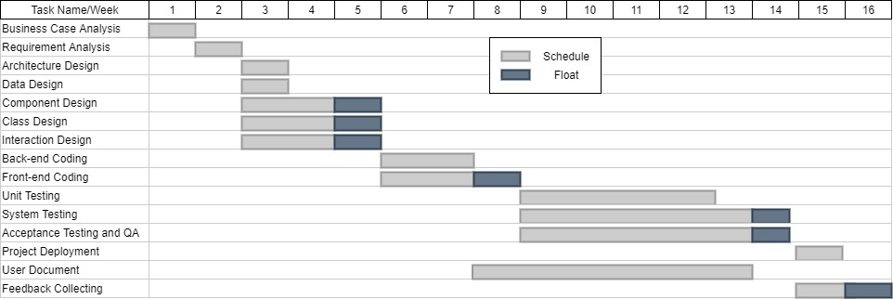
2
Relevant Gantt Chart
Relevant Gantt Chart shows more detailed information in the basis of CPG.
It leaves float slack time to give some space for adjustment.

Slide 17
3
Part 03
Risk Management

Slide 18
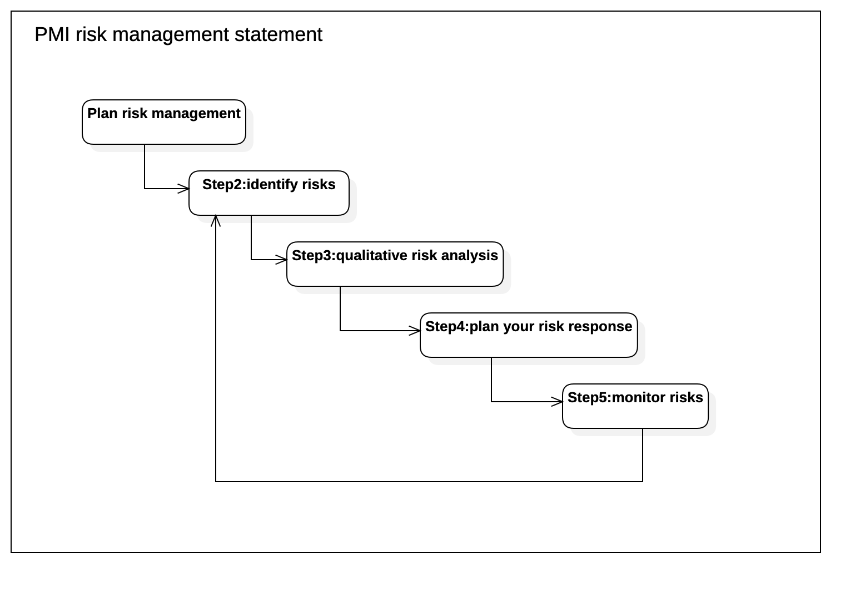
3
Risk Management Plan
Our team first formulated a risk management plan, based on the risk management steps of Project Management Institute(PMI) risk management.

Slide 19
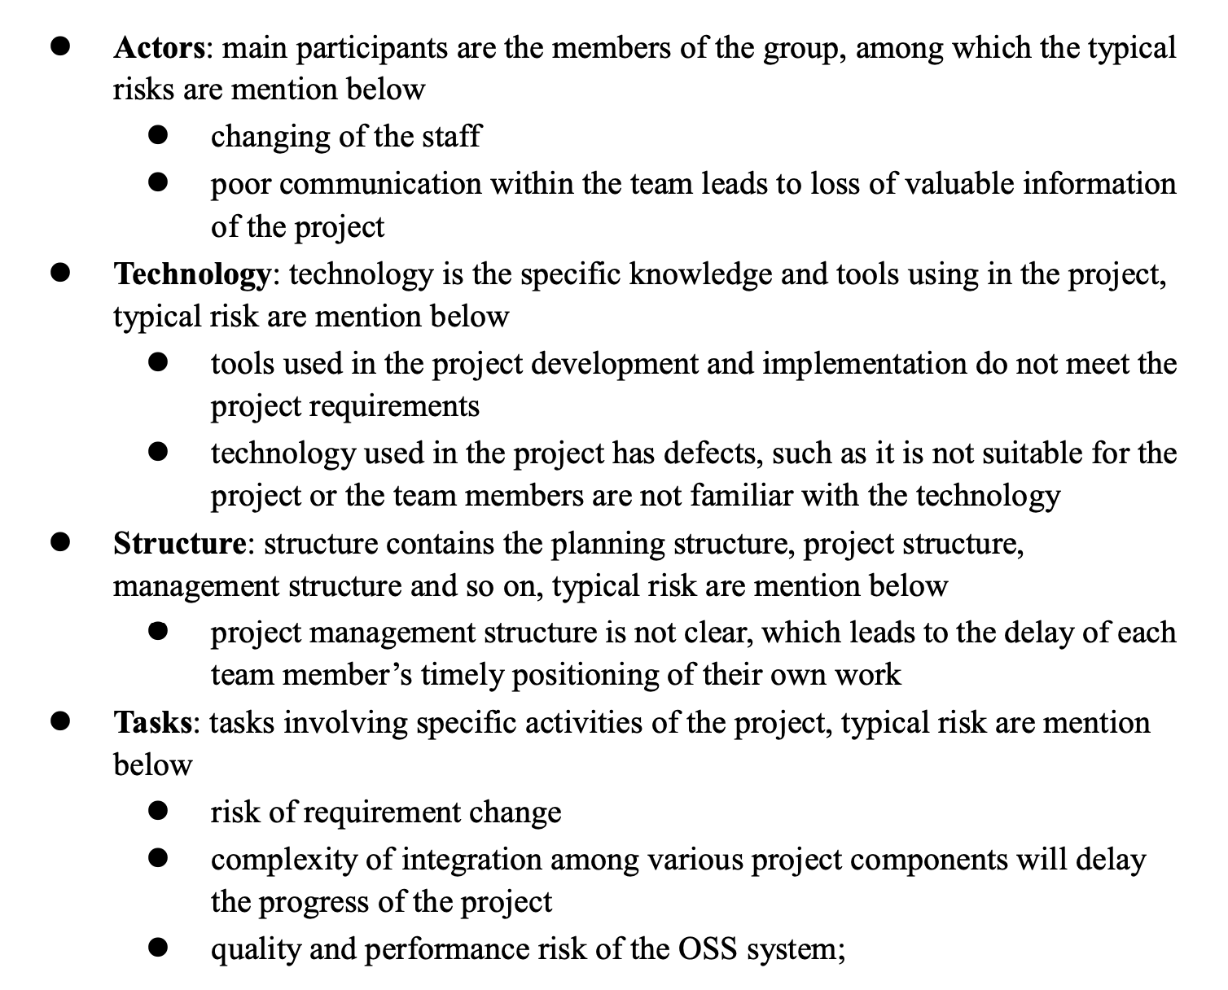
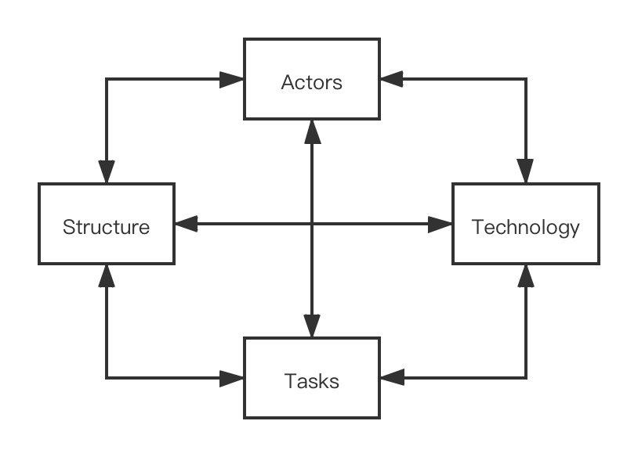
3
Categories of Risk
Then, in this part, we reference to “Lyytinen-Mathiassen-Ropponen” risk framework and we divided the risk factors into four parts.

Slide 20
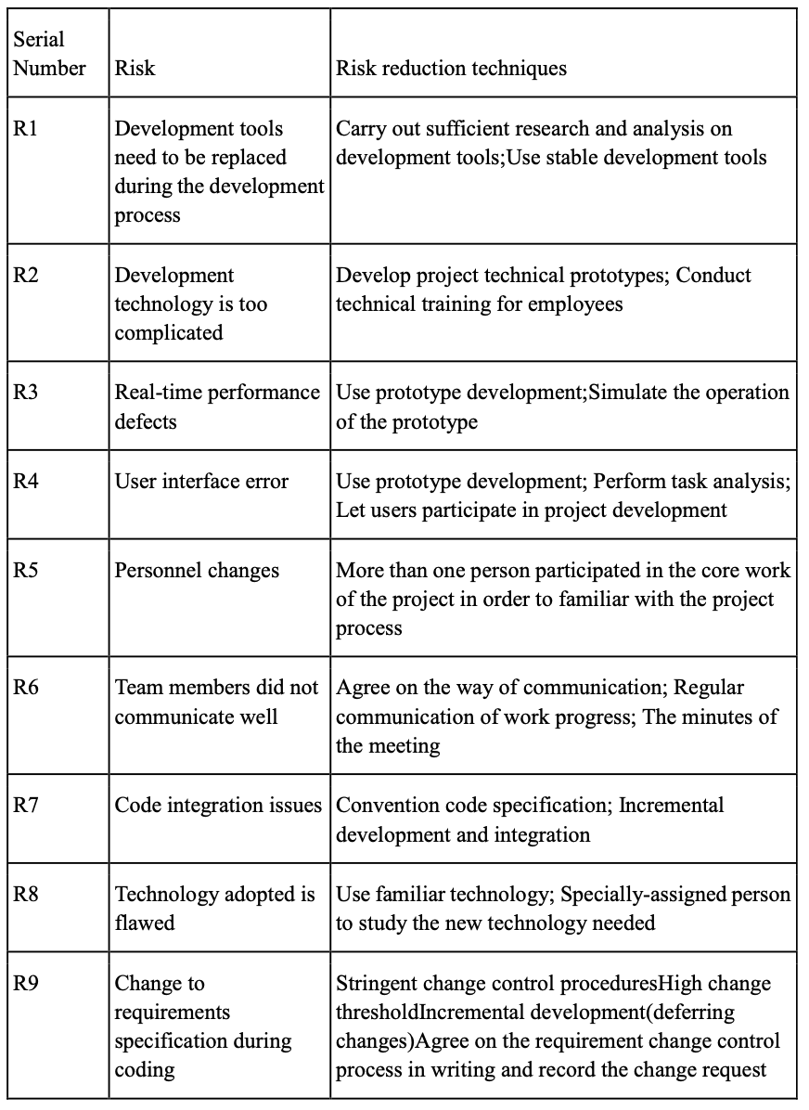
3
Risk Identification
In the risk identification of this project, we adopted the risk identification method combining Checklist method and Brainstorming method, referred to checklists models such as lyytinen model and Barry Boehm model, and established our own checklists as follows.

Slide 21
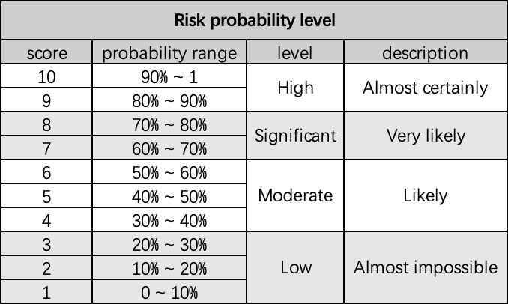
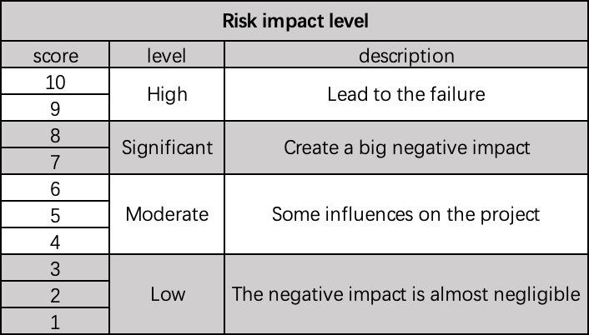
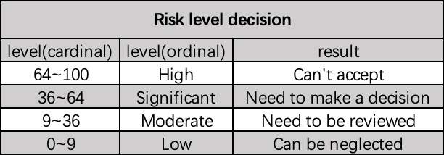
3
Risk Analysis, Assessment and Prioritization
Then we define the risk probability using score from 1 to 10, and we divide them into 4 levels from extra-high to extra-low.

Slide 22
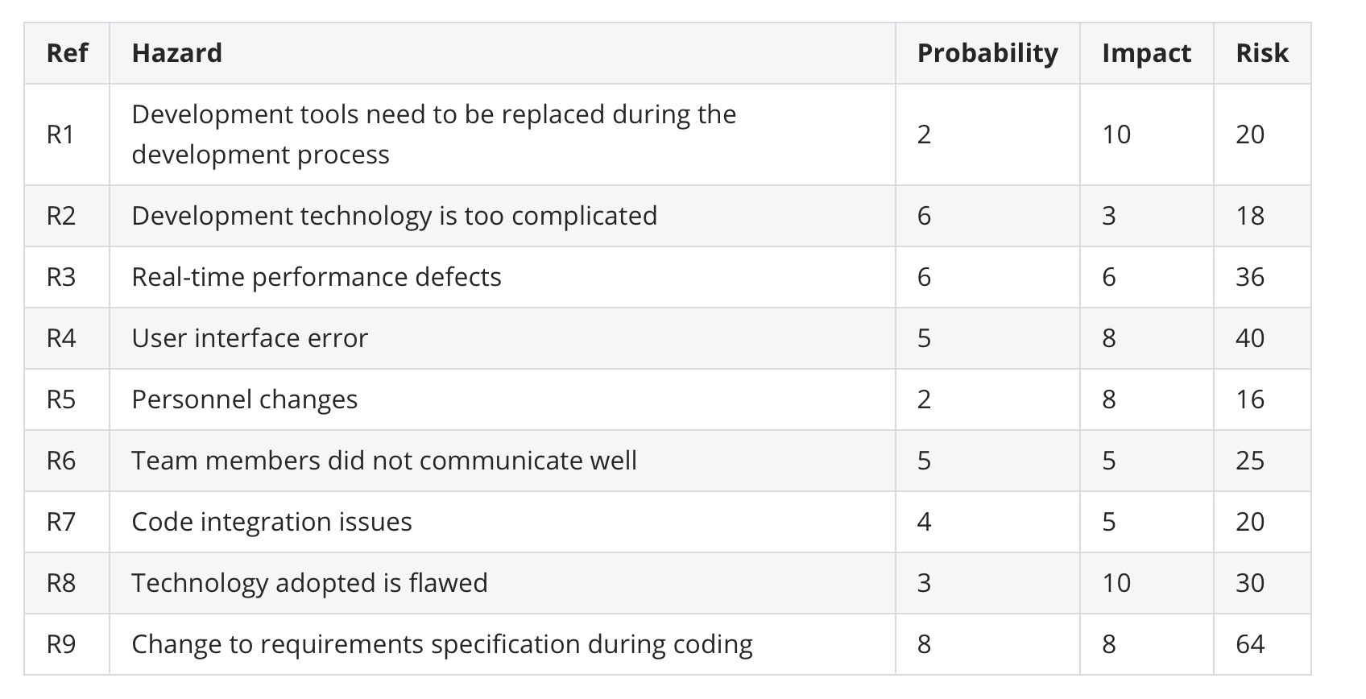
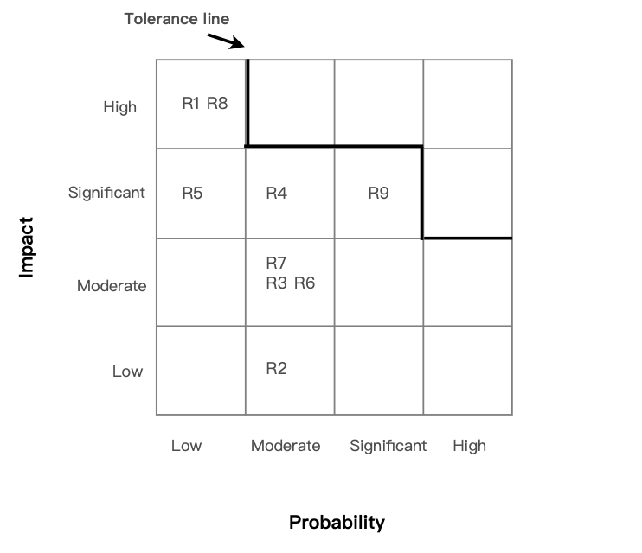
3
Risk Analysis, Assessment and Prioritization
After defining the levels, we analyzed the potential risks . Then we simulate the risk exposure during our brainstorming, and we use Barry Boehm's method for risk exposure assessment. The probability impact matrix is as follow.

Slide 23
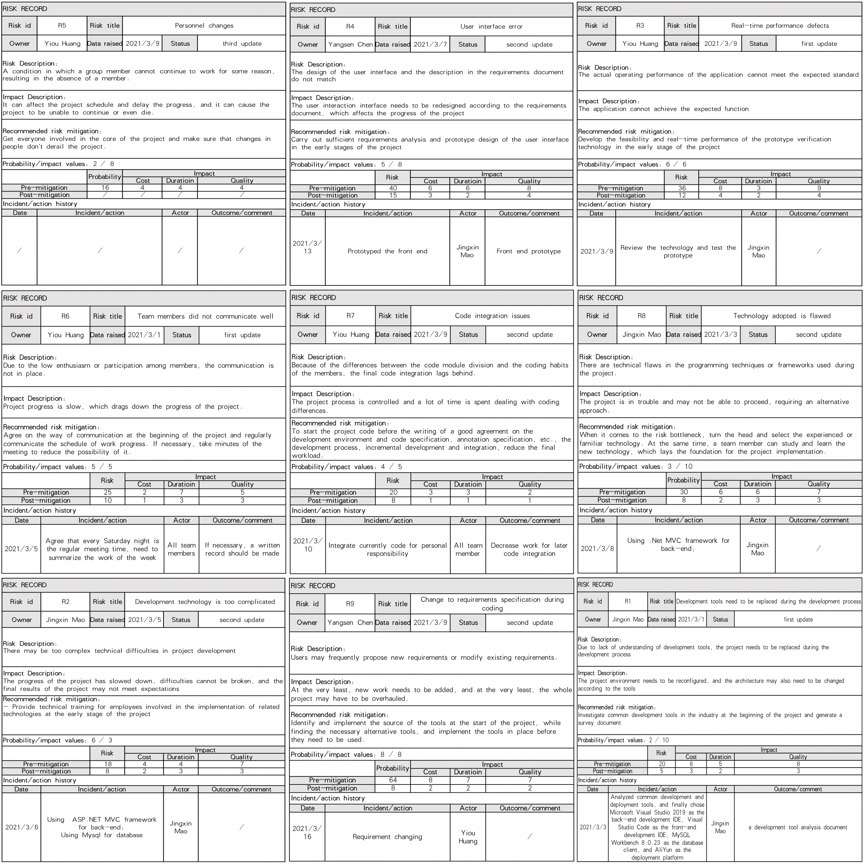
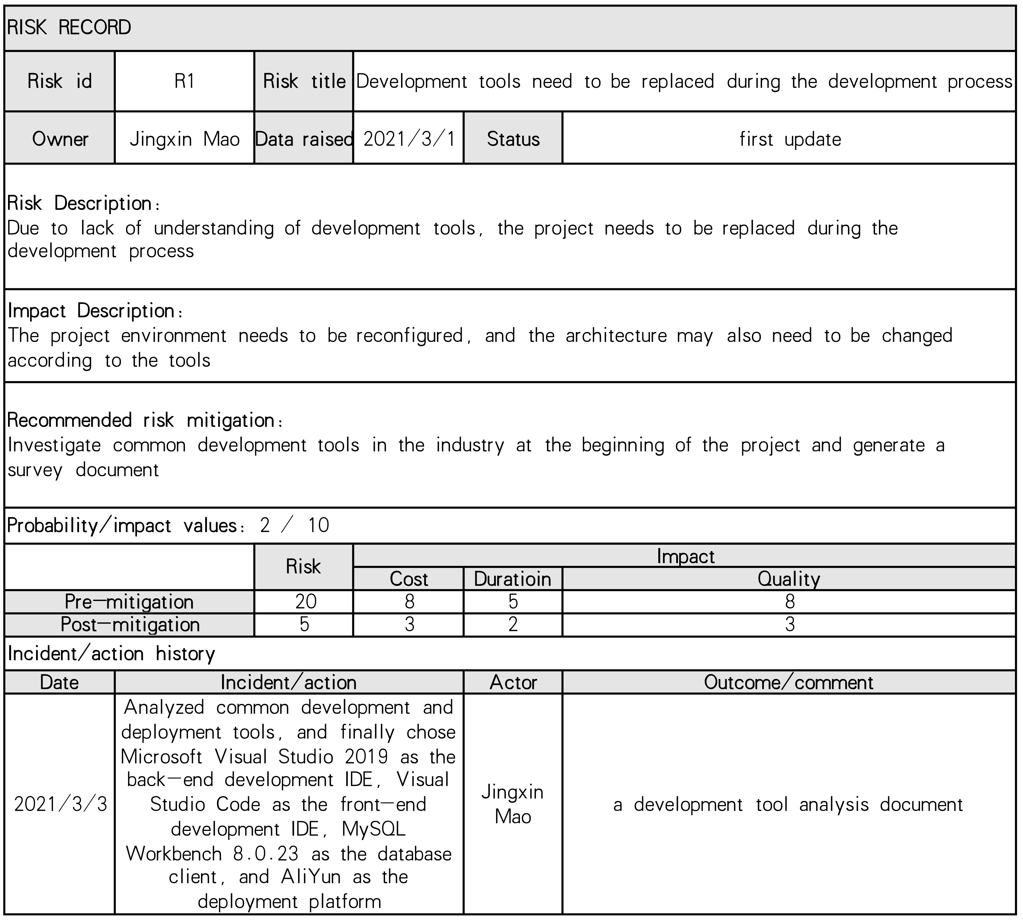
3
Risk Register.
We picked out and examined what appear to be the most threatening risks to the project, creating and maintaining our findings in a Risk Register.

Slide 24
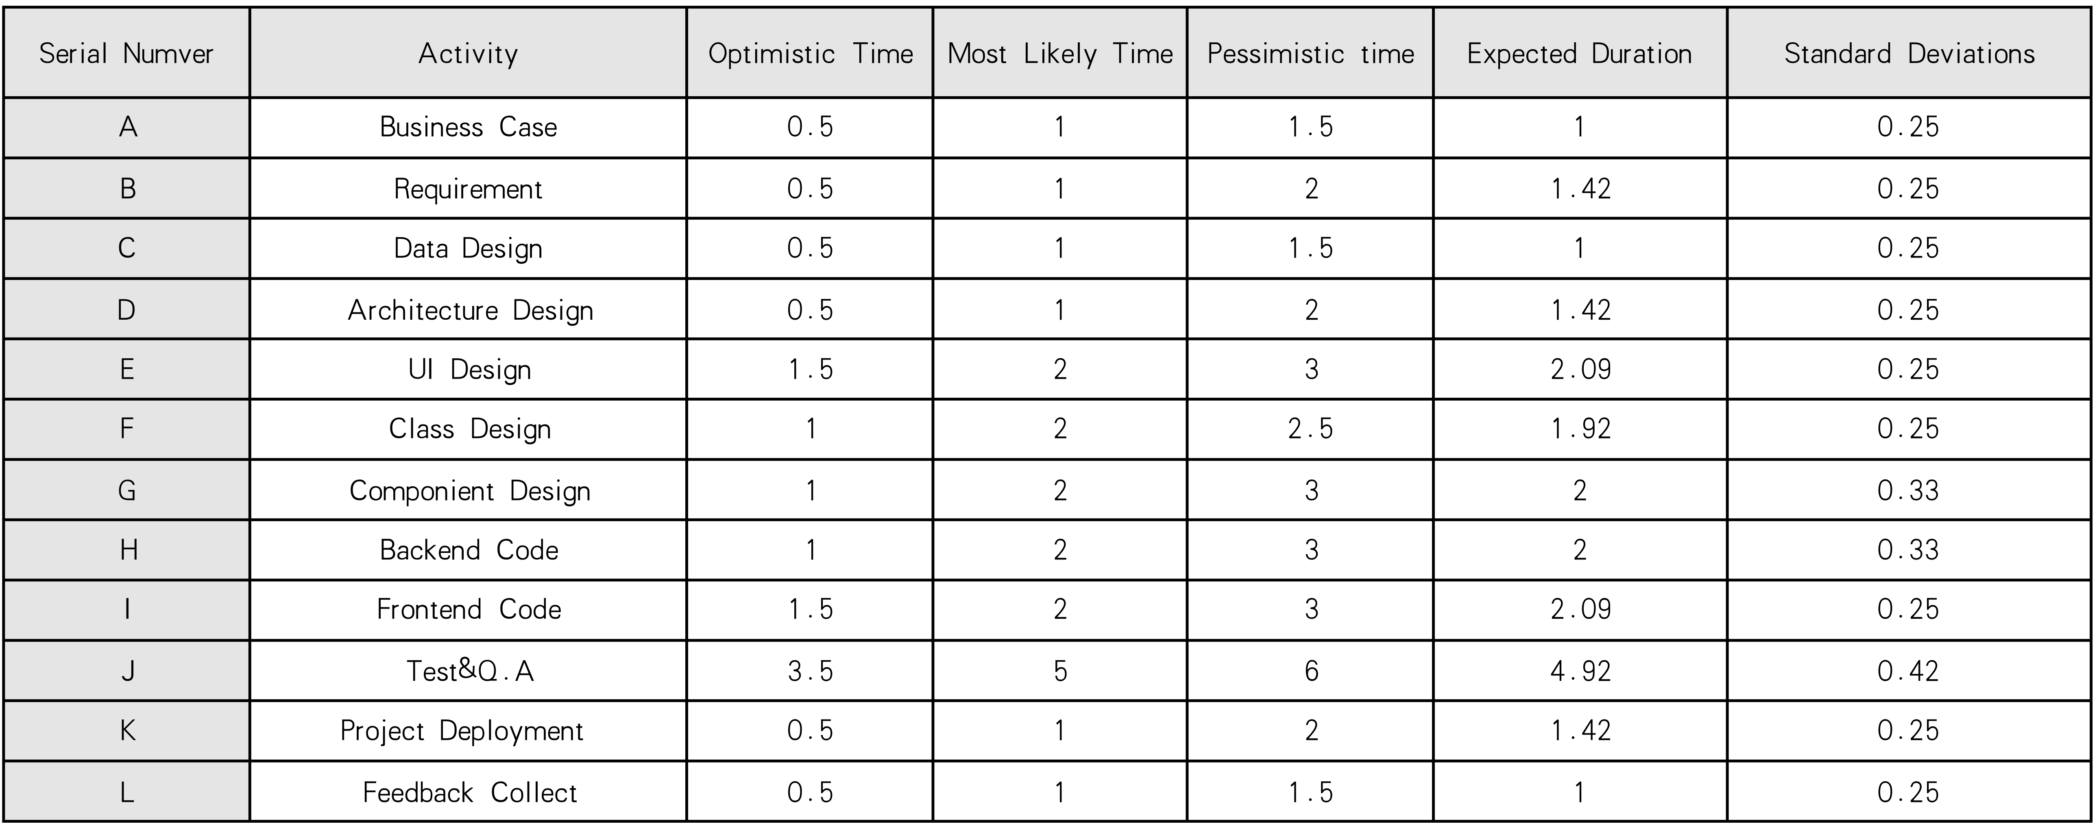
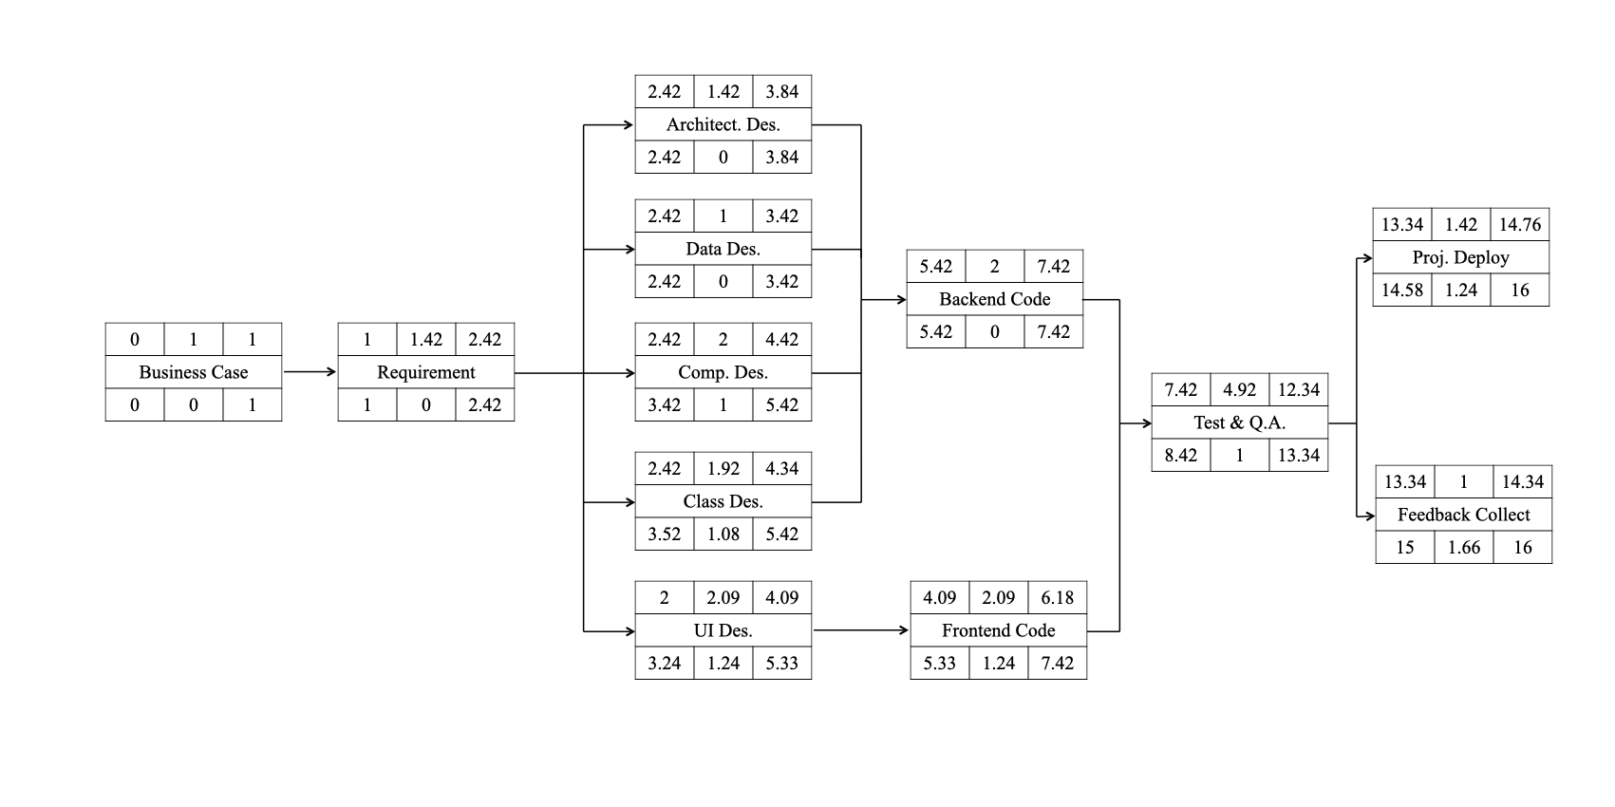
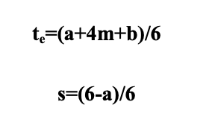
3
Risk Evaluation
PERT Activities Schedule
We use PERT(Program Evaluation and Review Technique) for risk evaluation. PERT was developed to deal with the uncertainly surrounding estimates of task durations.
First we divided the global task into sub-task, and estimating for three times, Most likely time(a), Optimistic time(m) and Pessimistic time(b), then using formula to calculating Expected Duration and Activity Standard Deviations
Project Cycle Activities Network Diagram

Slide 25
4
Part 04
Resource Allocation

Slide 26
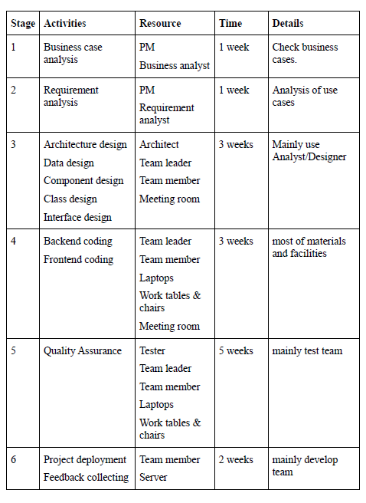
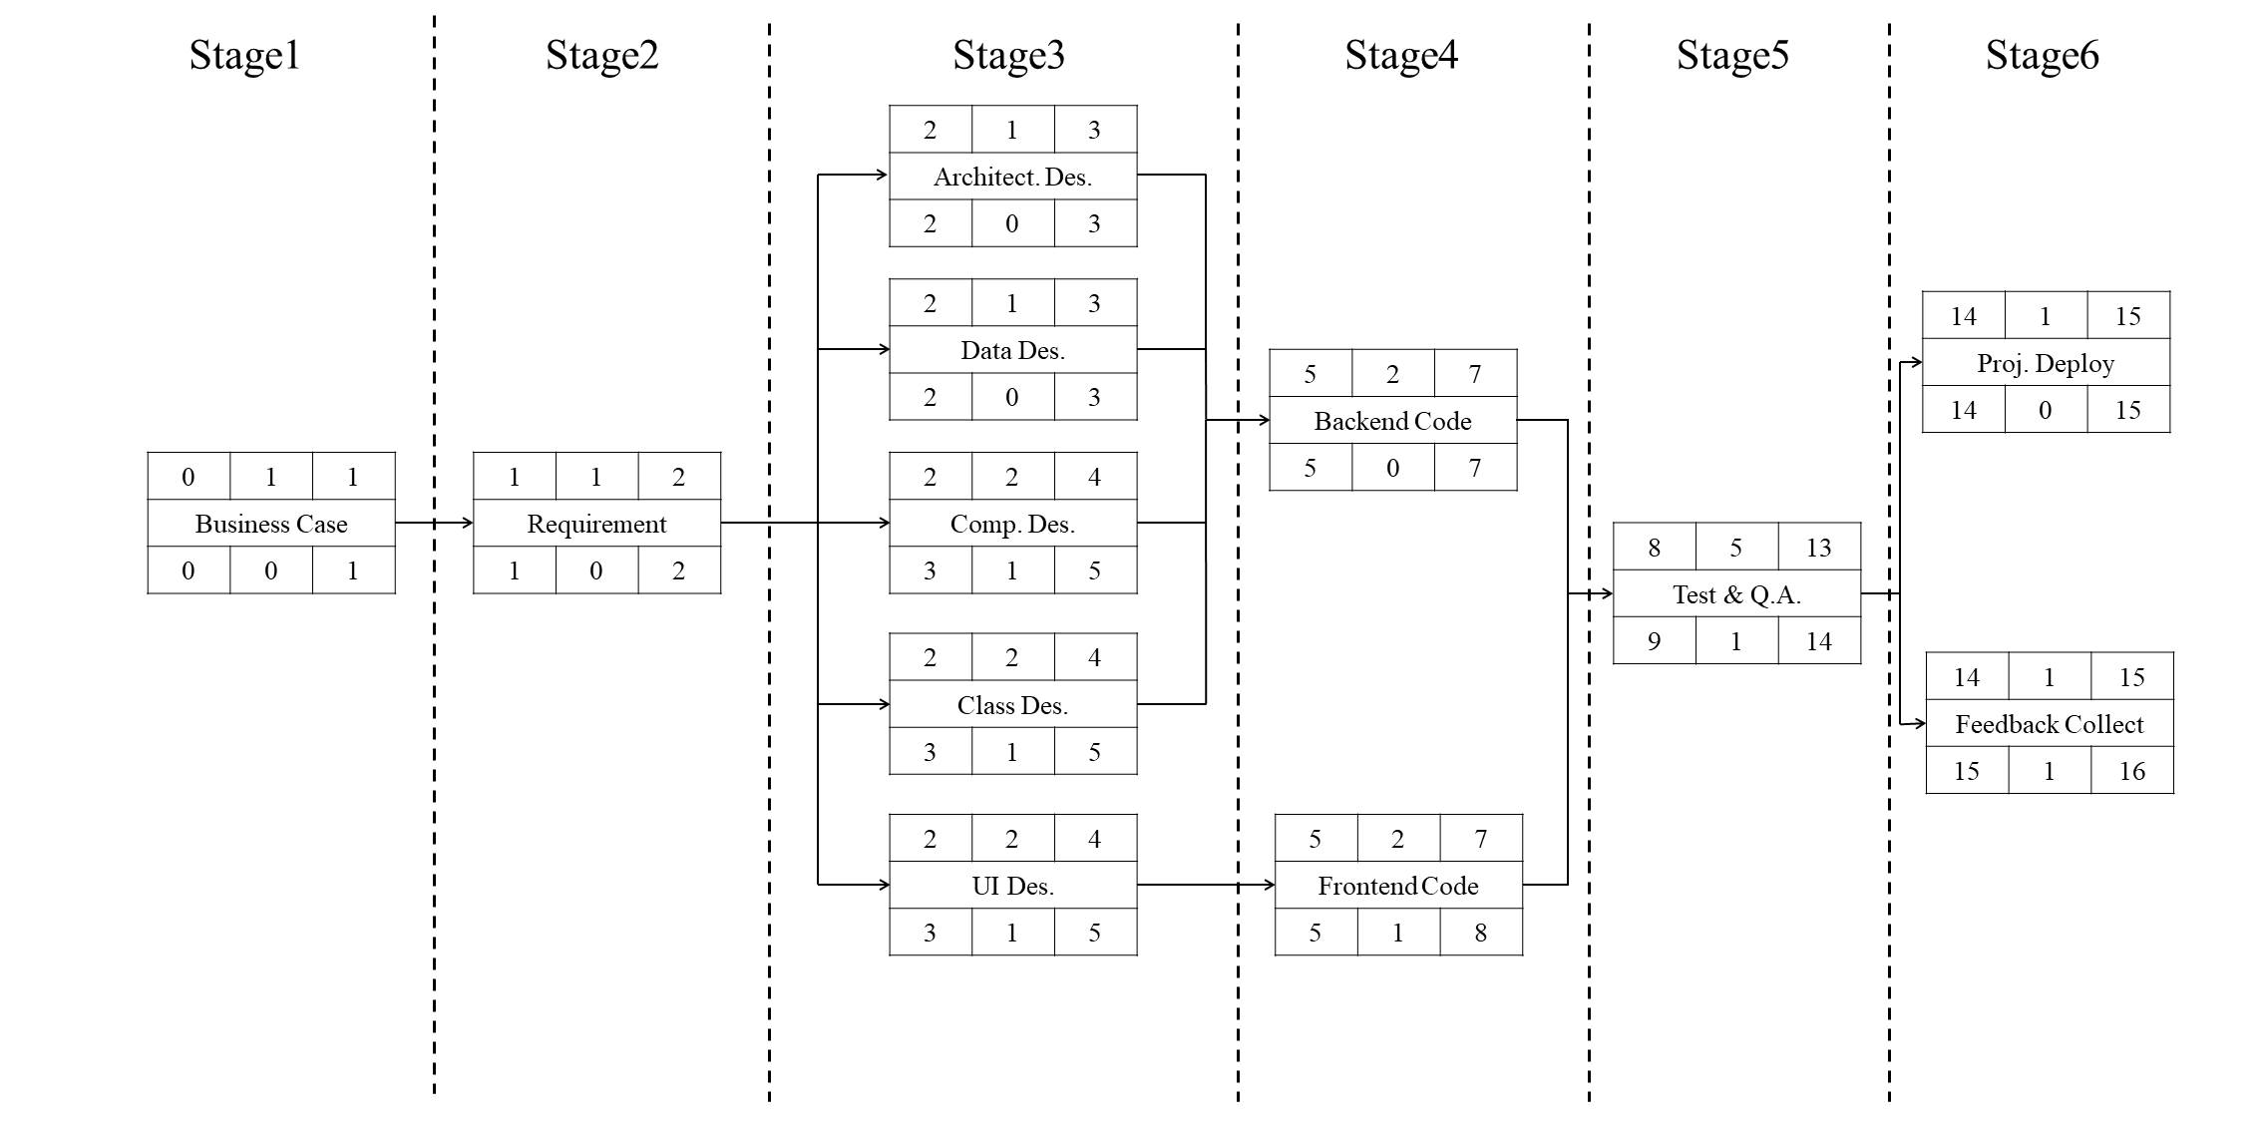
4
Identify Resource Requirement
The resource needed in every stage shows in the following Resource Requirement List.

Slide 27
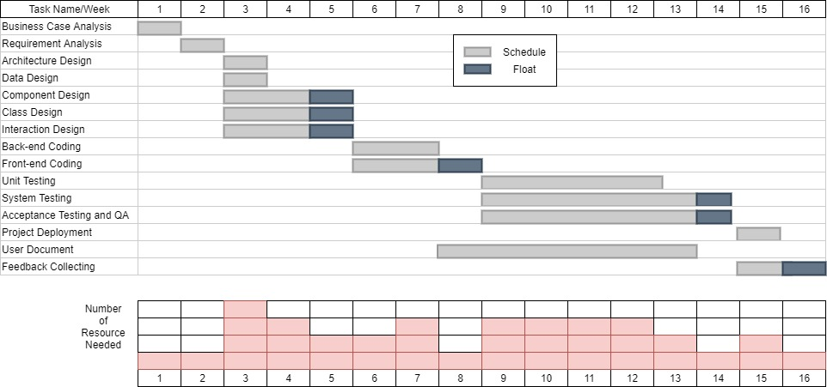
4
Resource Scheduling
The resource histogram exported by Gantt chart.

Slide 28
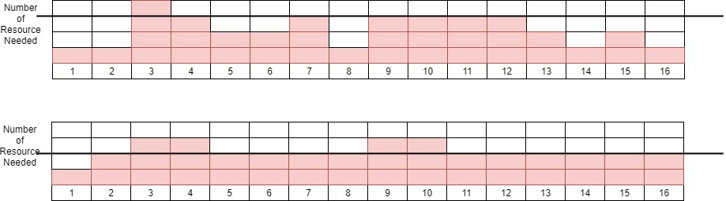
4
Resource Scheduling
We can adjust the start date of some activities and split other, our resource histogram can be smoothed to contain resource demand at available levels. Updated smoothing resource histogram chart is shown below.
We made the resource histogram more smooth so we can assure that we will get wanted resource at necessary time.

Slide 29
5
Part 05
Monitor and Control

Slide 30
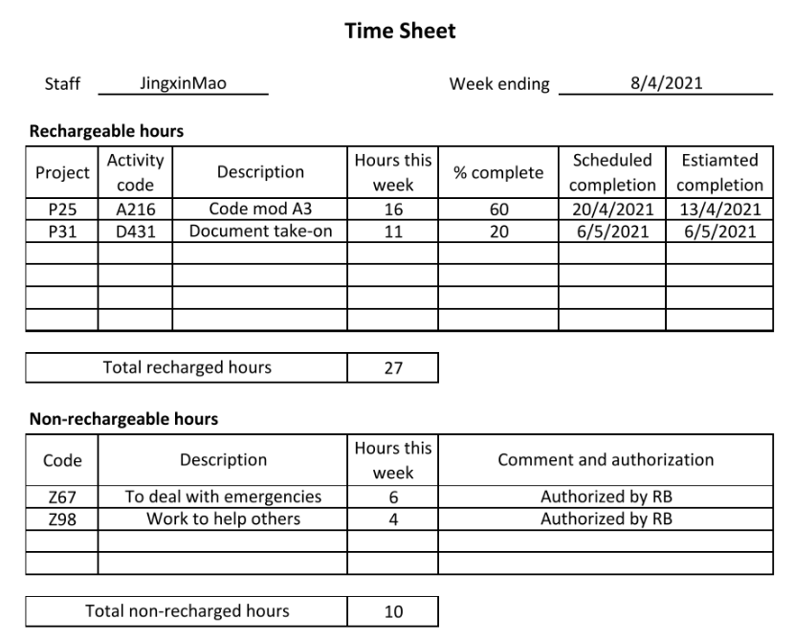
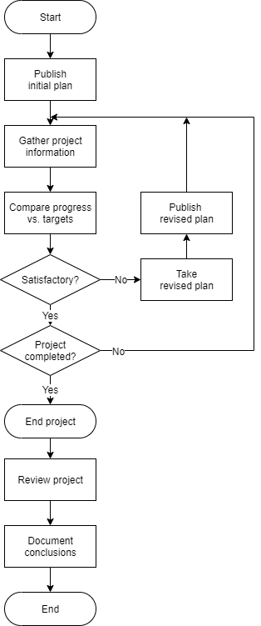
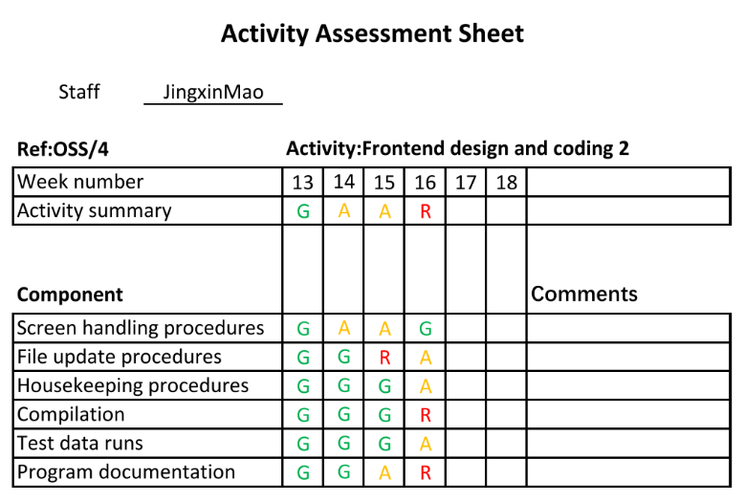
5
Project control framework
Data Collection
The left figure illustrates the project control cycle model
Every employee must confirm the risk report once a week.
The two simulation reports are as follows.
Notes:
左图说明了项目控制周期模型，并说明了一旦宣布初始项目计划，项目控制将是根据计划连续监视进度，考虑偏差并在必要时修改计划的过程。 该图还说明了项目完成后必须采取的一些重要步骤，以便将在任何项目中获得的经验应用于未来项目的计划阶段并从过去的错误中吸取教训。
每个人都应收集部分完成的任务。 在收集数据的过程中，有两种方法：部分完成报告和风险报告。 考虑到部分完成报告会减少员工的注意力并可能导致延误，因此将部分完成报告的任务留给产品经理进行生产和分析。 每个员工必须每周确认一次风险报告。 这两个报告如右。 由于没有实际的过程参考，因此对教科书进行了适当的修改以适应示例报告。

Slide 31
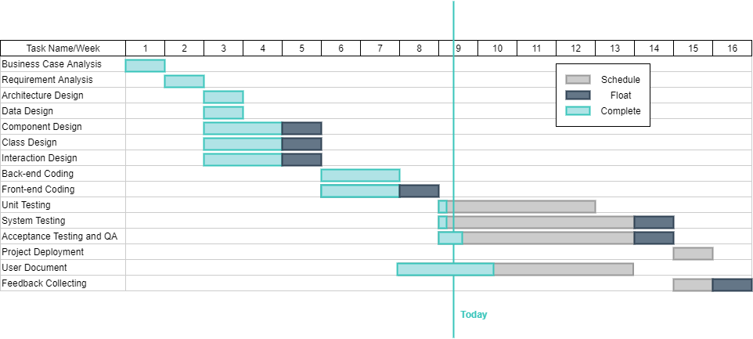
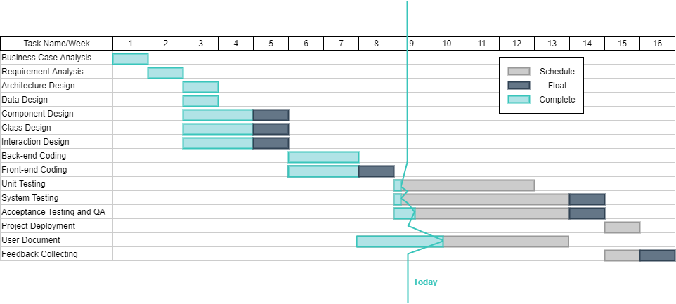
5
Progress Visualization
The Gantt chart
The slip chart

Slide 32
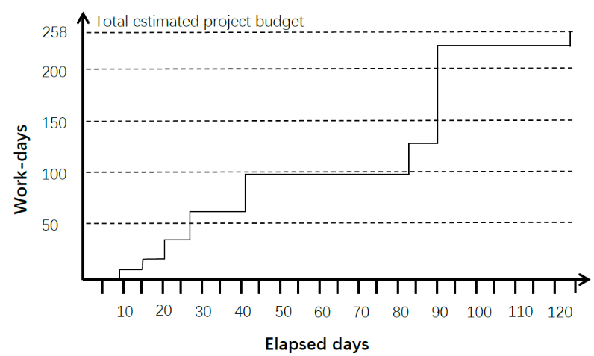
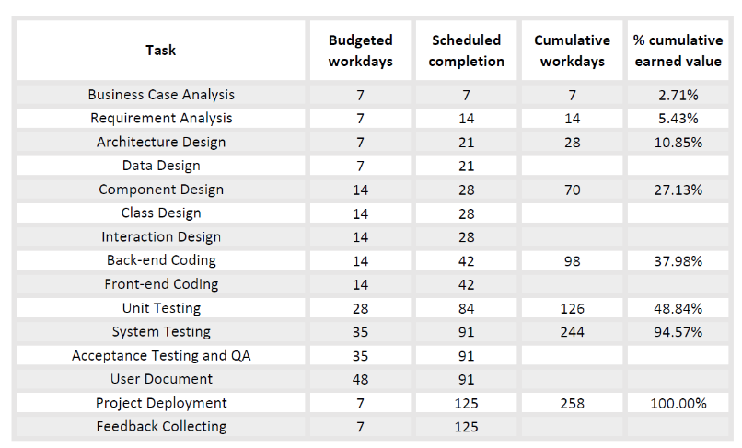
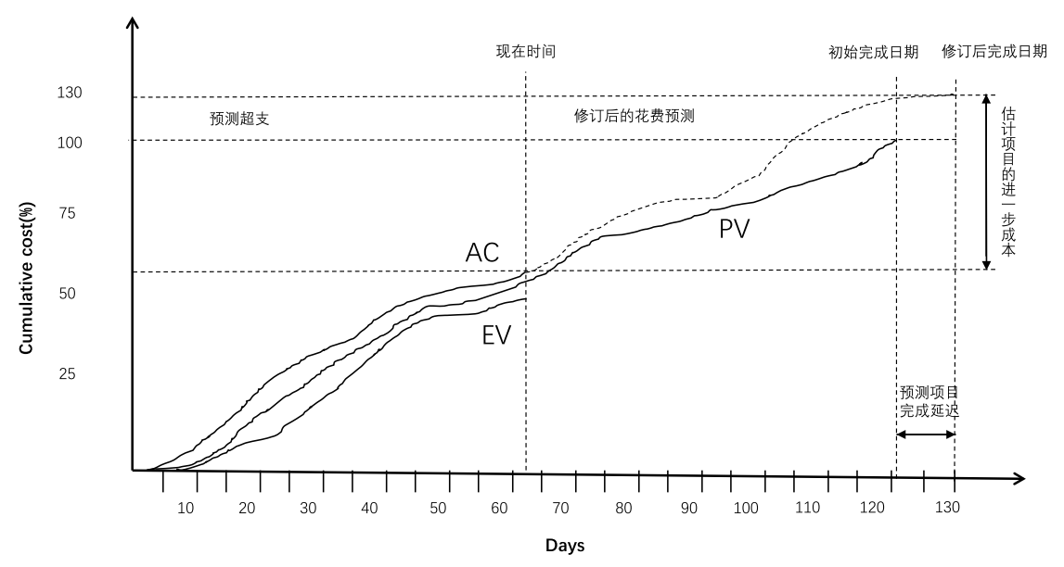
5
Earned Value Analysis
We combine the Baseline Budget and 0/100 technology, assign 0 to unfinished tasks, and 100% to tasks that have completed the budget.
CV(Cost variance) = EV – AC
SV(Schedule variance) = EV – PV
CPI(Cost Performance Index) = EV / AC
SPI(Schedule Performance Index) = EV / PV

Slide 33
6
Part 06
Project Implementation and Prototype

Slide 34
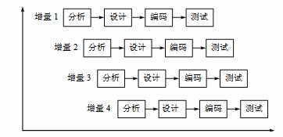
6
Process Model
Meetings
Meeting | Time and Task
Planning Meeting | Every Saturday at 14:00. Arrange next week's task Daily Meeting
Retrospective Meeting | Every Saturday at 14:00, review last week's accomplishments before the planning meeting and dynamically adjust the tasks for the next week
Development Tools
Tool | Illustration | Offical Web
Microsoft Visual Studio 2019 | IDE | https://www.microsoftstore.com.cn/software/visual-studio
Visual Studio Code | IDE | https://code.visualstudio.com/
MySQL Workbench 8.0.23 | Database design tool | https://dev.mysql.com/downloads/workbench/
AliYun | Deployment platform | https://cn.aliyun.com/
Development Environment
Environment | Version | Download Url
Asp.net MVC | 3 | https://www.microsoft.com/zh-cn/download/details.aspx?id=4211
Mysql | 5.7.30-winx64 | https://downloads.mysql.com/archives/community/

Slide 35
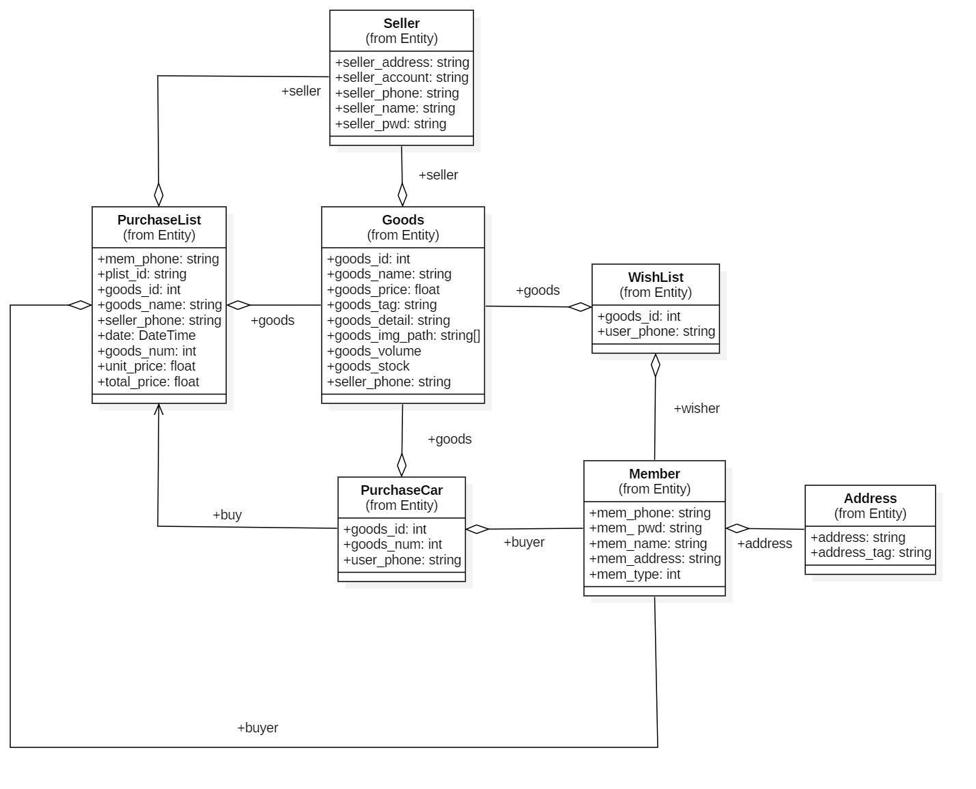
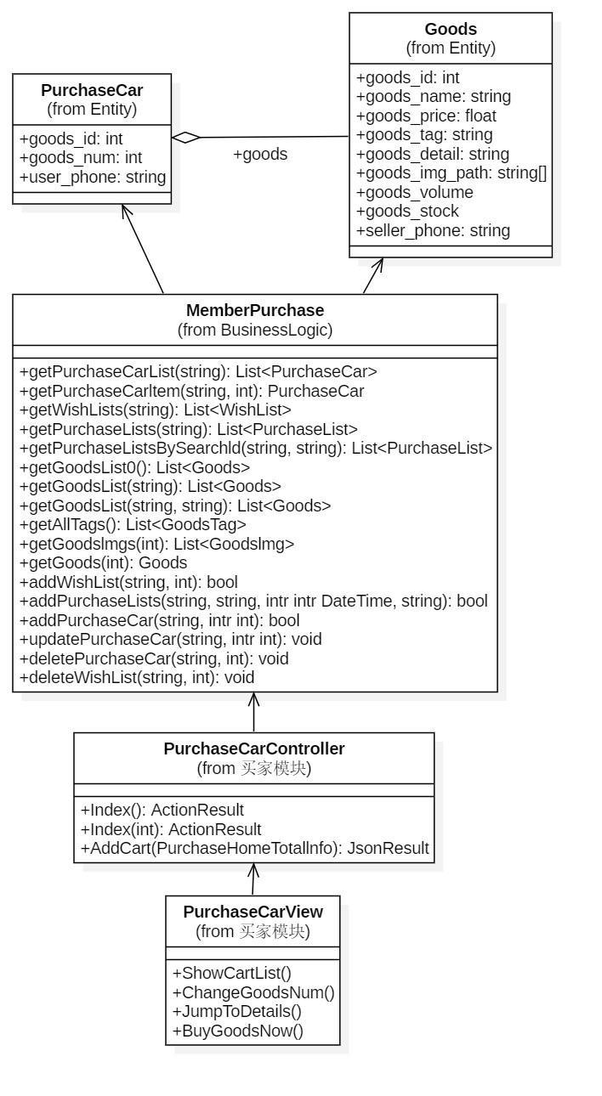
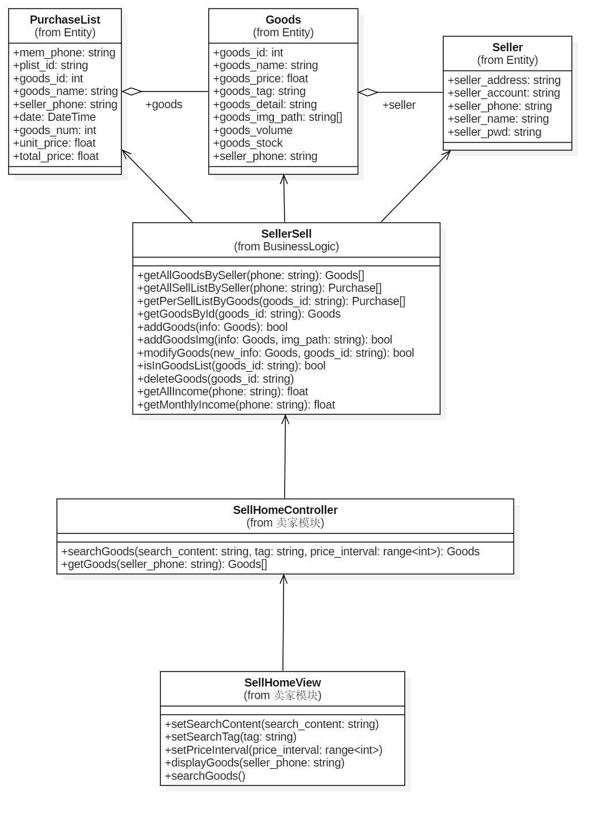
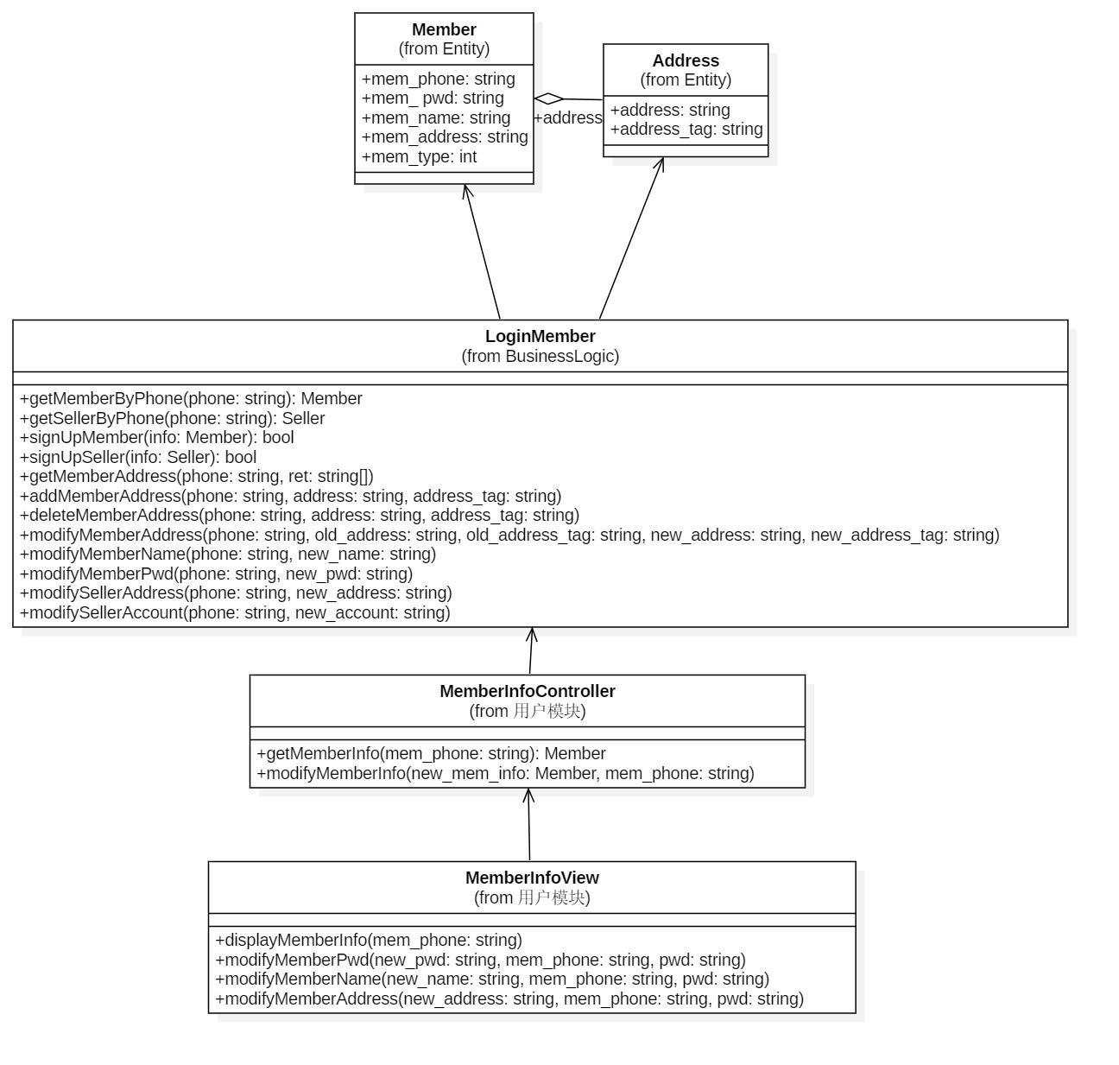
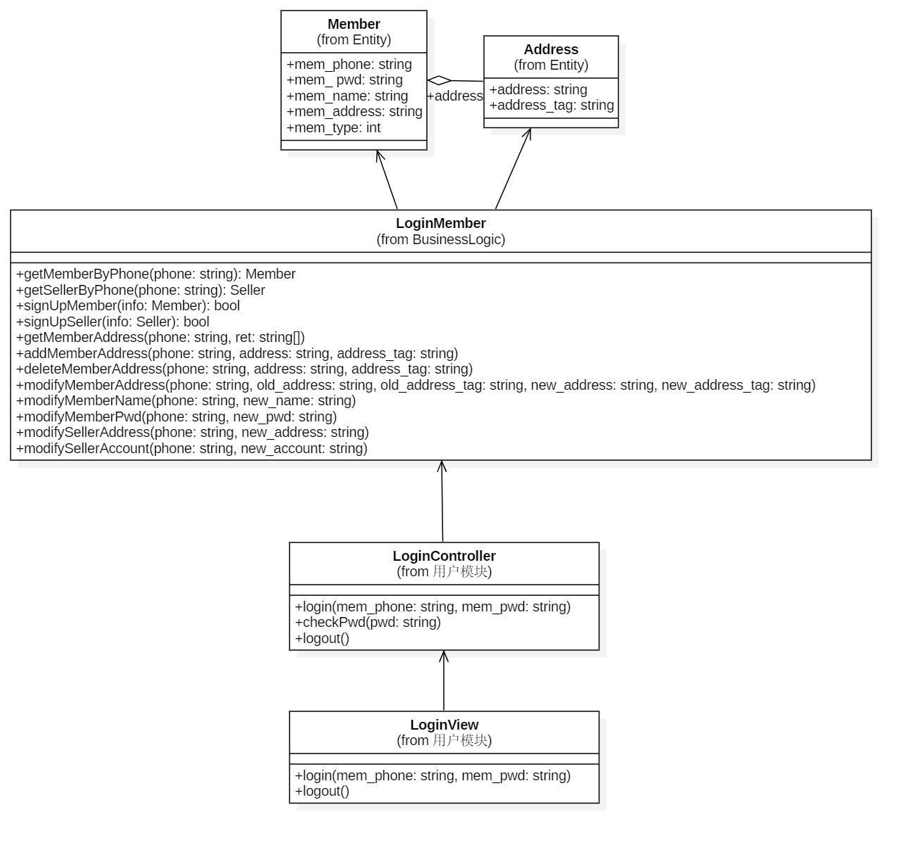
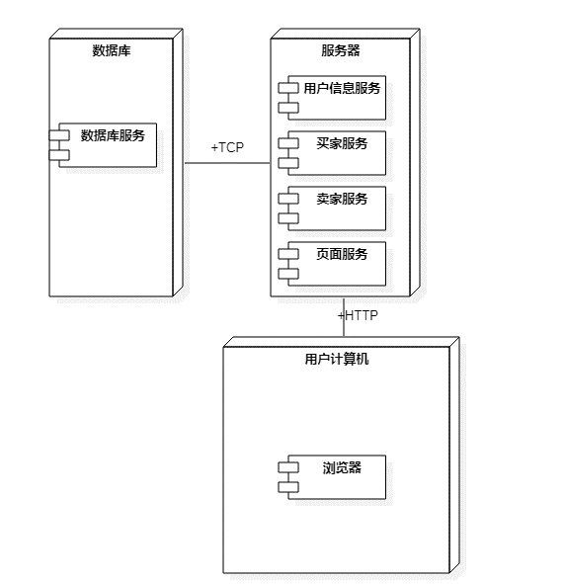
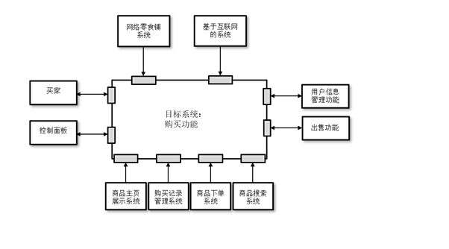
6
Design Elements

Slide 36
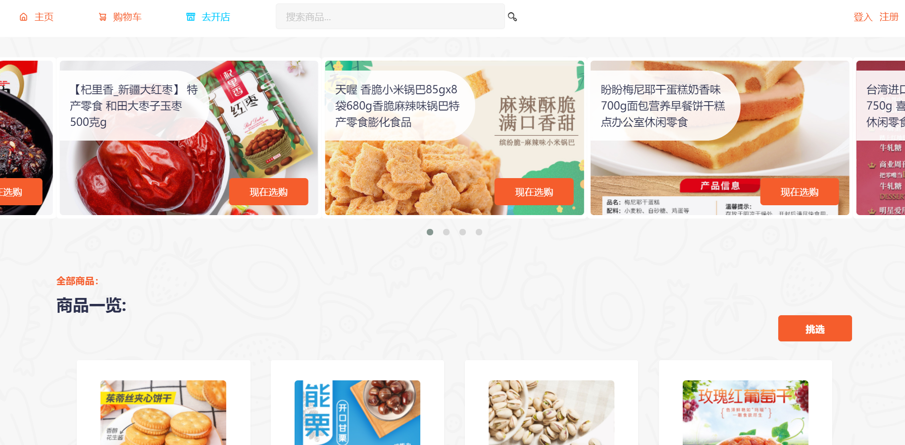
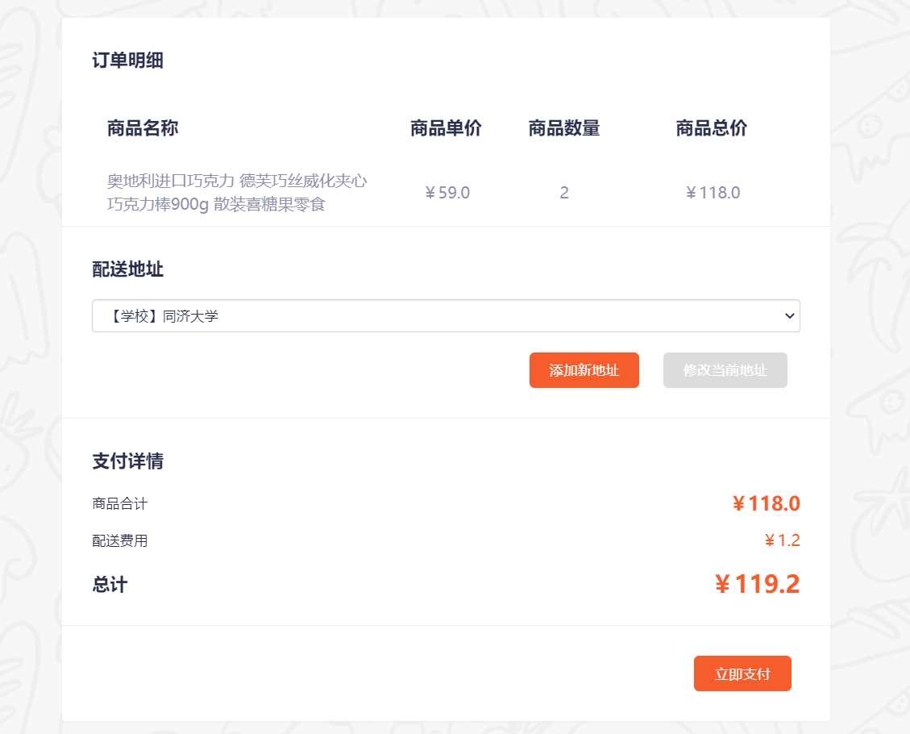
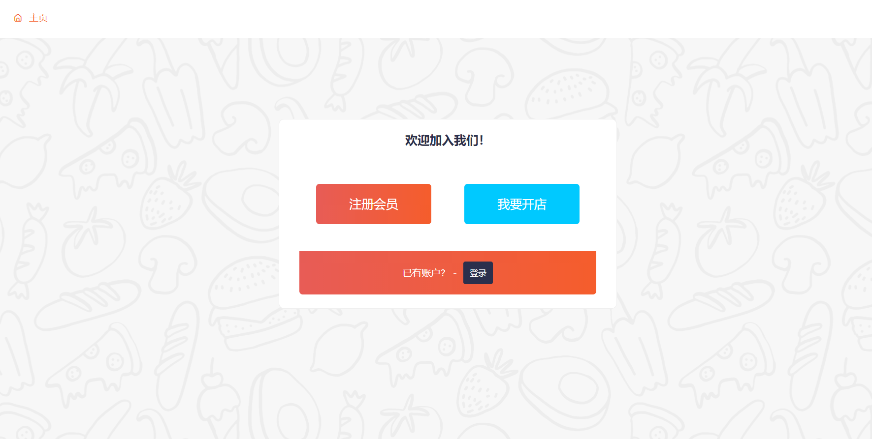
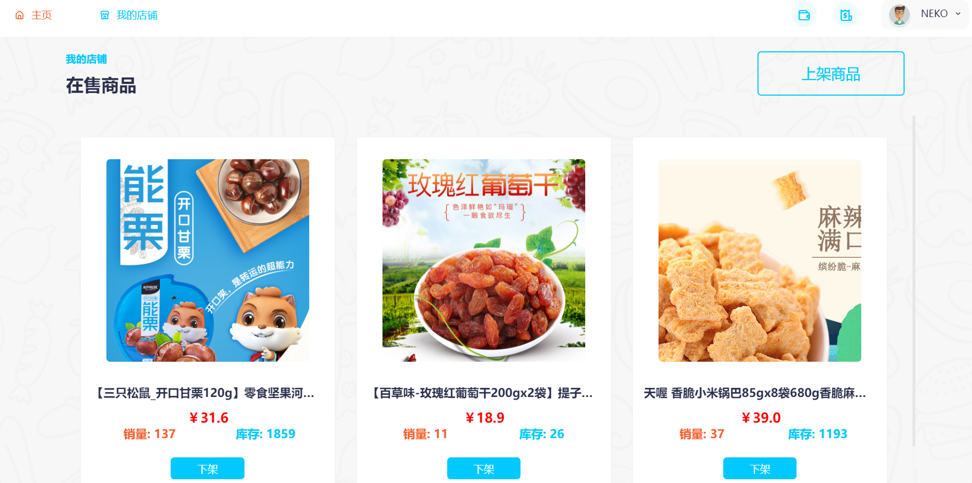
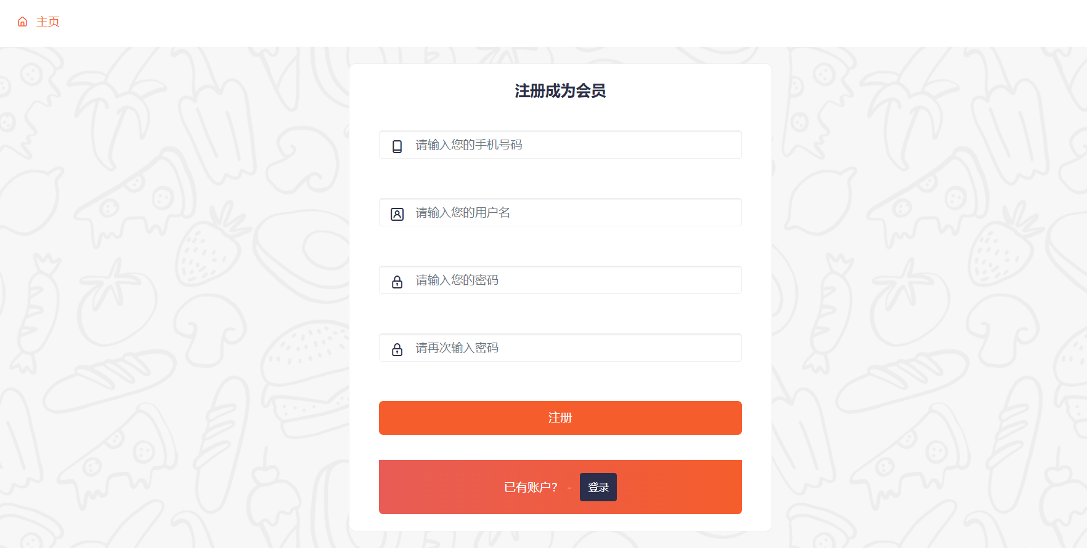
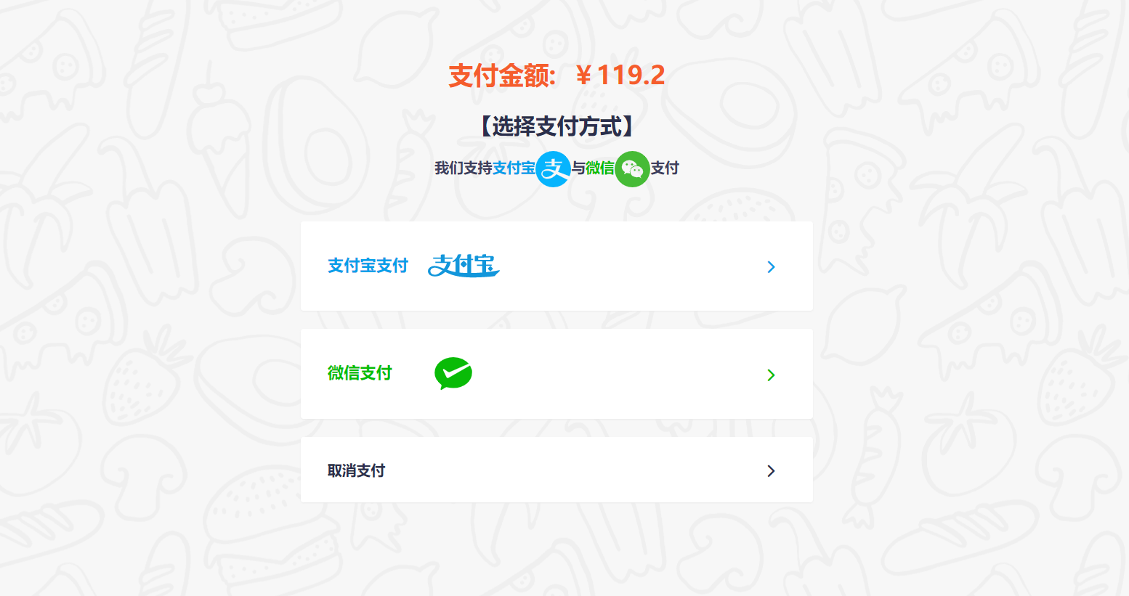
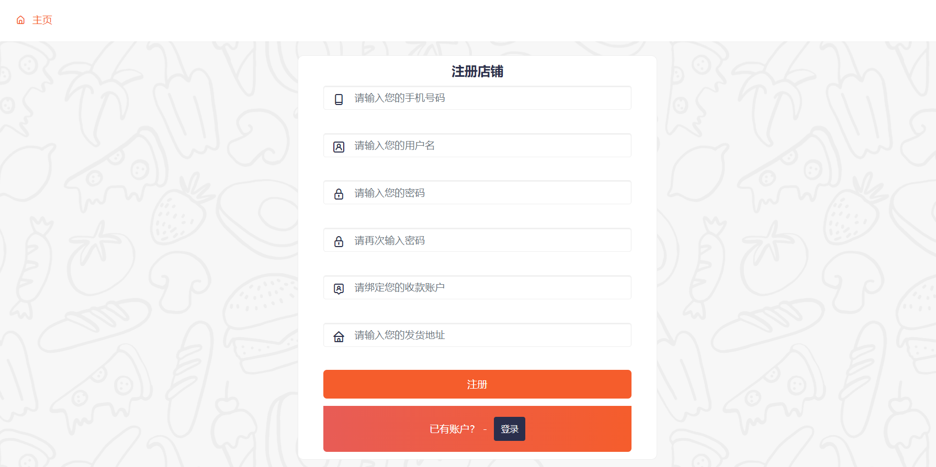
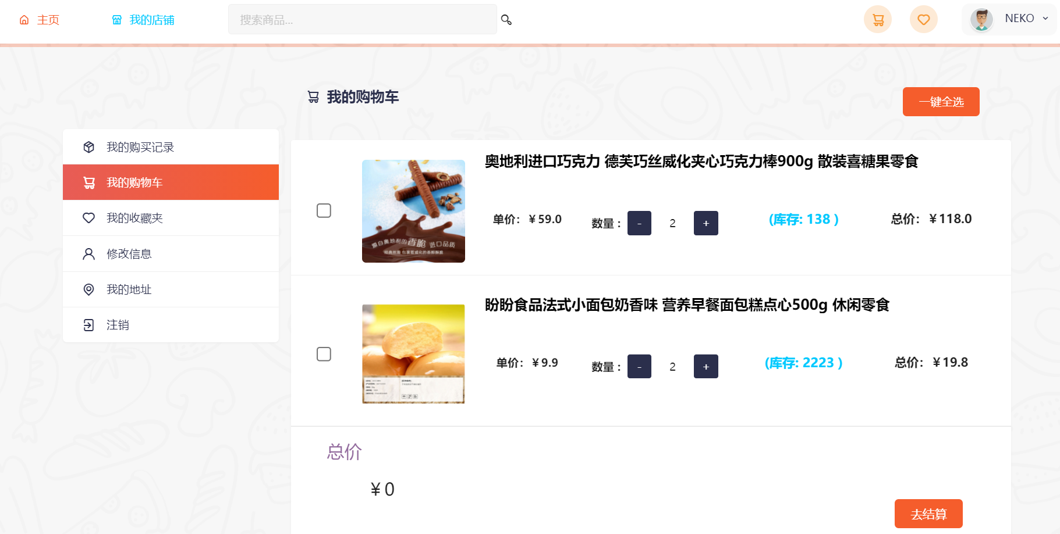
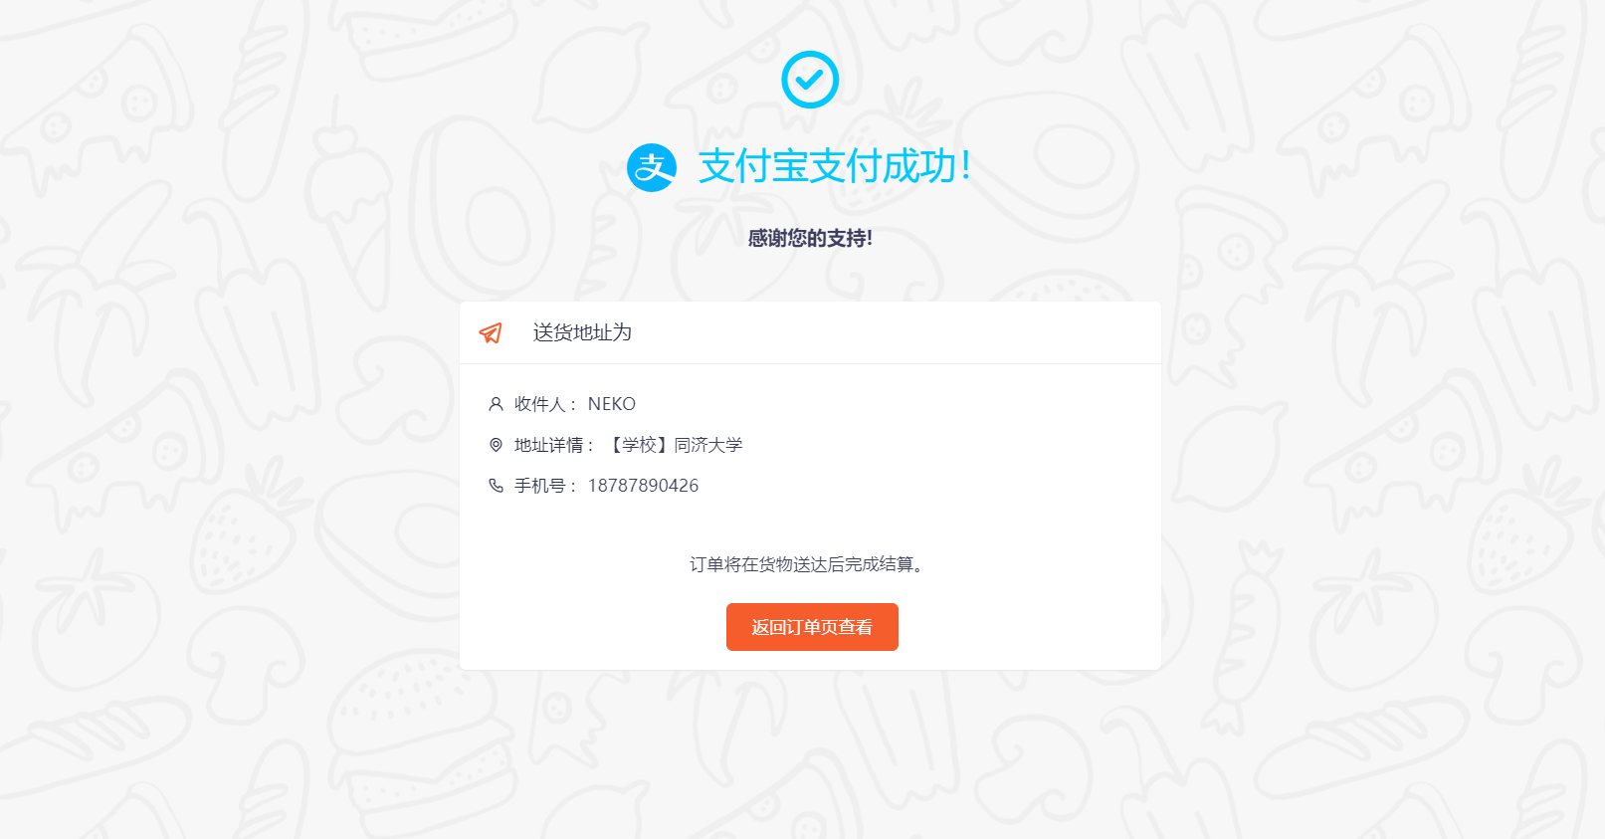
6
Partial Prototype Display

Slide 37
Thank You
.
.
.
References
Kathy, Schwalbe. Information Technology Project Management 6th.
Robert Hughes et al.Software Project Management.5thEdition.2009
Notes:
大侠素材铺 淘宝店：https://dxpu.taobao.com/

